Slide 1
Logo-focused title page
With a short subhead

Slide 2
[TEXT] is the #X Corporate Campaign in the Valley
$XXM
XXX
2021
CAMPAIGN STATS
RAISED
DONORS
COMPARED TO COMPANIES AND ORGANIZATIONS
OF SIMILAR EMPLOYEE SIZE
PARTNER HIGHLIGHTS
1. One
2. Two
3. Three
4. Four
5. Five
Text xx
Text xx
Text xx
Text xx
Text xx

Slide 4
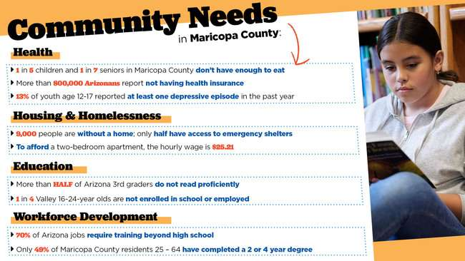

Slide 11
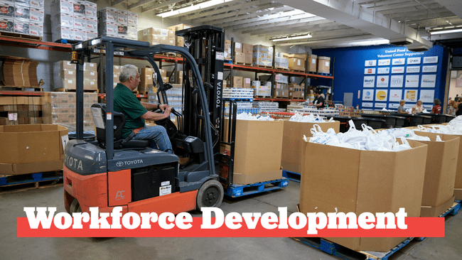

Slide 14
